Slide 1


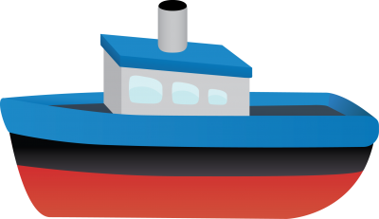
RSA - Project Presentation
Automatic Nautical Sensor Data Collection
Tiago Marques - 98459
Bruno Lemos - 98221

Slide 2
Objectives
Develop an autonomous system which allows to collect nautical information
Safety : No need human intervention
Efficiency : Autonomous system are better than other methods
Environmental monitoring : Maintain water quality
Base Station (RSU)
Receive all the information coming from the autonomous boats
Start operation and sharing sensor location information
Autonomous boat (OBUs)
Three autonomous boats to cover a significant area of ​​water
Navigation system
Sensors
Temperature, Conductivity, depth
ph, dissolved oxygen, nutrient_levels
oxygen, carbon dioxide, methane

Slide 3
Simulation Environment
We make use of:
5 Docker Containers (3 Boats, 1 Base Station, 1 Watcher)
1 Hosted MQTT Broker
Watcher: used to simulate the communication range between the boats and between the boat and base station
Sensors: boat arrives at the sensor location, it publishes a message on the hosted mqtt broker, this message is processed by a python script that randomly generates the information that would be collected by a real sensor. This generated information is published in the hosted mqtt broker arriving at the boat that requested the sensor information.

Slide 4
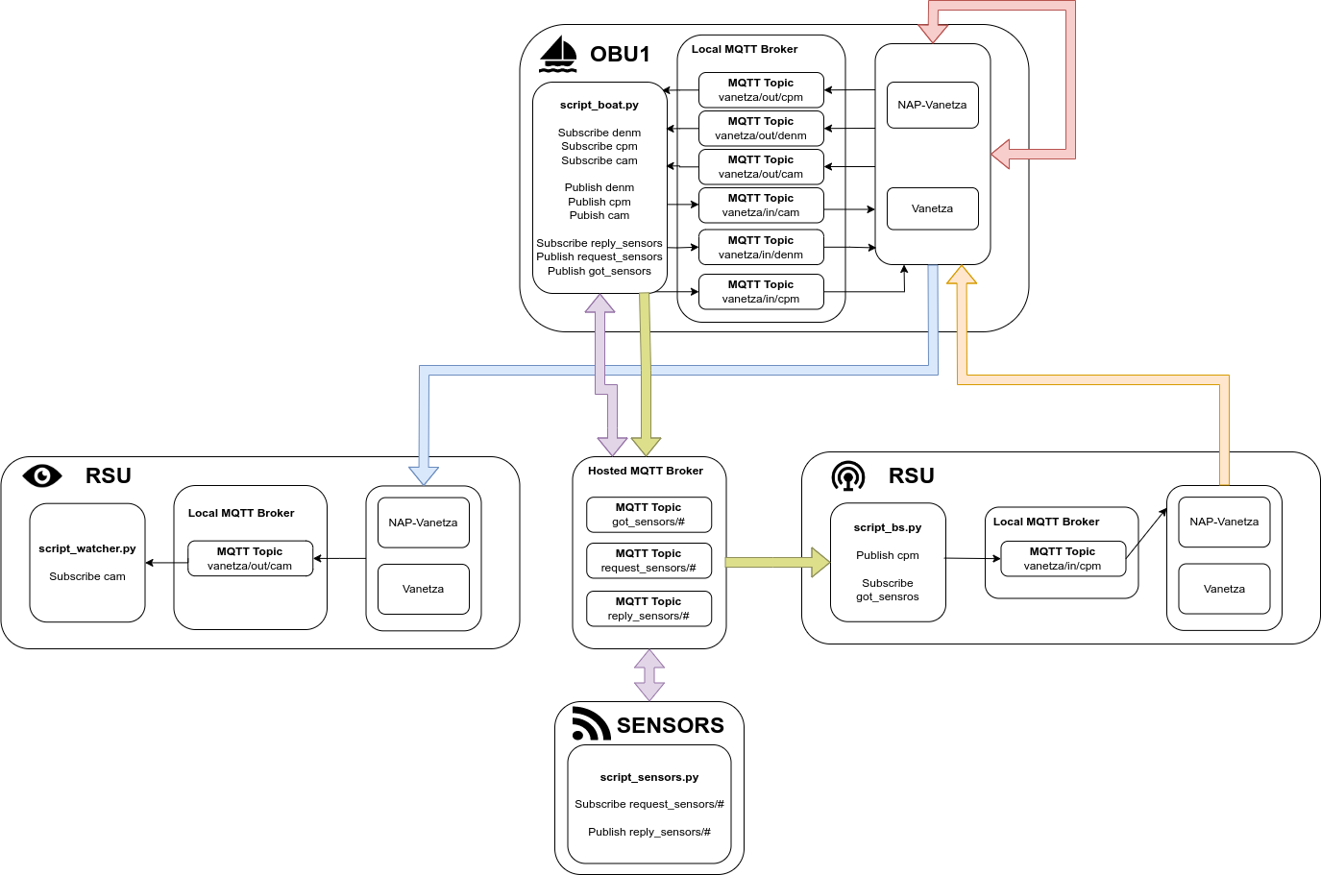
A
r
c
h
i
t
e
c
t
u
r
e

Slide 5
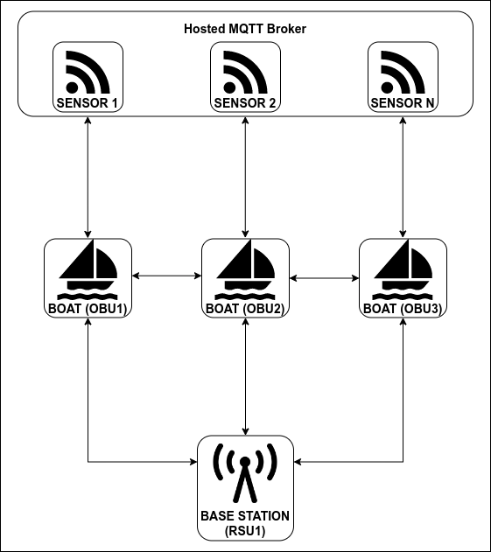
Diagram of Implementation
Message Types
Between OBUs
cam | Send current and future position
denm | Send the picked sensor position
cpm | Send unavailable sensors
RSU to OBUs
cpm | Send location of sensor in the water
OBUs to RSU
got_sensors | Sends the data collected from the sensors
Between OBUs and Sensors
request_sensors | Sends the location of the desired sensor
reply_sensors | Replies with the data collected by the requested sensor

Slide 6
Timeline
OBU
OBU
OBU
SENSOR
OBU
RSU
RSU
OBU
OBU
Start Operation
Moving
Collect Data
Delivery
Send cpm message with location of all sensors
The boats receive the cpm message and start moving
The OBU sends a request for the sensor info, the sensor replies with the data it collected.
The OBU arrives at the base station and sends the collected sensor data to the RSU.

Slide 7

Timeline - Between Moving and Collect Data
OBU
OBU
OBU
OBU
OBU
OBU
Receives DENM
Receives CPM
Announce Picked Sensor
Send Current and Future Positions
Announce Unavailable Sensors
The message is received. If this OBU has the same sensor picked, it checks if he is closer to the sensor, if so it keeps the sensor else it picks another sensor from the available ones
The sensors in the message are removed from the available pool, if not already. If the picked sensor suddenly becomes unavailable another sensor is picked from available pool
The OBU announces the sensors it’s going to collect, broadcasting DENM messages
The OBU makes use of the cam messages to send to the other boats it’s current position and future position. Thus allowing others in the vicinity to know it’s position
The OBU announces the sensors that are already collected by him and by the others, broadcasting CPM messages

Slide 8
DEMO

